Slide 1
COMPSCI 345 SOFTENG 350 Human-Computer Interaction (HCI)
Professor Jim Warren
Associate Professor Beryl Plimmer
Craig Sutherland

Slide 2
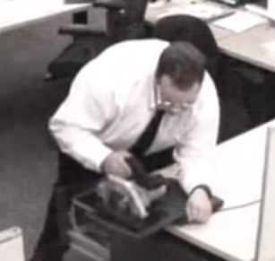
Why HCI?
https://www.youtube.com/watch?v=WXJZXR5Qb-8

Slide 3
Today’s learning objectives
Meet the lecturers
Be able to define HCI
Be able to articulate the importance of HCI to the success of modern software
Be aware of the course structure and organisation
Appreciate the role of the assessable components in your learning of HCI

Slide 4
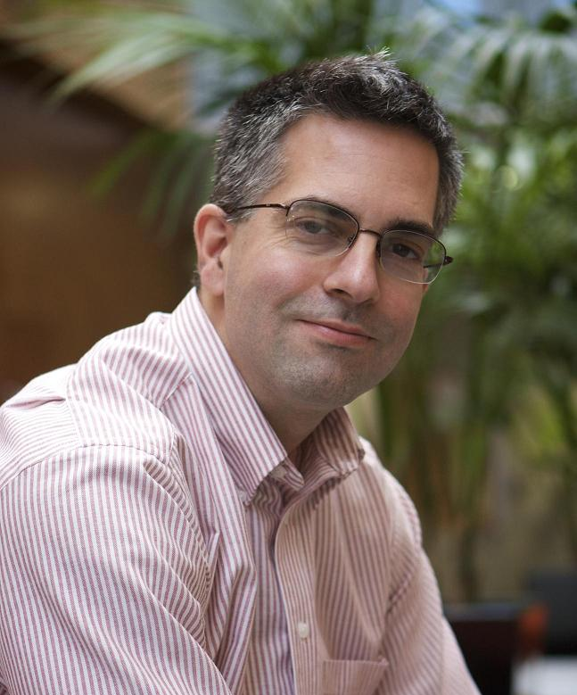

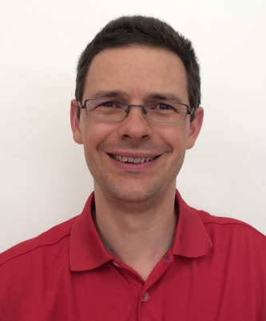
Lecturers
Prof Jim Warren
Course Coordinator
jim@cs.auckland.ac.nz
Ext: 86422
Room 303S.483
Office hours: by appointment
Research: Health informatics, decision support
Assoc Prof Beryl Plimmer
beryl@cs.auckland.ac.nz
Ext: 82285
Room 810.833
Office hours: 2:30 – 3:30 Tuesday
Research: HCI, Tangible computing
Craig Sutherland
cj.Sutherland@auckland.ac.nz
Ext: 89357
Room 810.827
Office hours: by appointment
Research: Code comprehension, pen-based computing

Slide 5
Tutors and Markers
The tutors are
Bibin Varghese bpad682@aucklanduni.ac.nz
Reshmi Ravichandran rrav495@aucklanduni.ac.nz
Sam Kavanagh hganavak@gmail.com
Markers are five graduate students who excelled in COMPSCI 345
Tutors will manage all interactions with the markers

Slide 6
What is HCI?
“Human-computer interaction is a discipline concerned with the design, evaluation and implementation of interactive computing systems for human use and with the study of major phenomena surrounding them.” (ACM SIGCHI)
Main elements of HCI are:
People
Computers
Interaction
Activities
Environment
[Video games aside…] People don’t use computers because they want to use computers – they do so to perform some task or activity, to achieve a particular goal.

Slide 7
Motivation
>50% of code in a software project deals with the interface
Major determinant of success of a system
Business view
Get the most out of your human resources
Marketplace view
There is a choice of systems
Expectation of ease-of-use
System view
Complex interface between computers and humans
Human factors view
Limitations to what humans can do (morale, time, attention)
Social view
A medium to connect us

Slide 8

USS Vincennes and Aegis (1988)
© Wikimedia Commons
Cool computers… bad outcome….

Slide 9
USS Vincennes and Aegis (1988)
“The Pentagon issues a statement that the Vincennes has downed an Iranian F-14 fighter. The Navy dismisses Iranian reports that an unarmed civilian jetliner has been shot down. Minutes later, the Navy issues a correction; they have indeed shot down, by mistake, Iran Air 655. 290 people were aboard. There were no survivors” (Lee, 1992, p. 233)
In his final report on the incident, Fogarty concluded that Aegis had provided accurate information. The crew had somehow misinterpreted the data. … The operators had fallen victim to the one major flaw of the Aegis … “seemingly trivial design decision.”
“The radar image of the Airbus on one of the giant computer screens displayed the airplane’s position and heading. But critical information about the plane’s altitude was omitted, and instead displayed on different consoles. Correlating the two pieces of information proved difficult at best.”
Recommended human engineering so that Commanding Officer can separate crucial information from other data, and vital data is displayed so they don’t have to shift attention back and forth between displays (Lee, 1992, pp. 234-5)

Slide 10

Relevance of context
The Vincennes with new Aegis technology was rushed to the Persian Gulf in midst of rising tensions
The crew had a complex, stressful day and was expecting trouble
Earlier a US helicopter was fired on by Iranian patrol boats while observing them
Vincennes was chasing the patrol boats
Both the Americans and Iranians had violated Oman territorial waters and had been confronted and sent off by the Omani navy
The Vincennes was pursuing the patrol boats into Iranian territorial waters
It’s world leaders, not designers, that created the recipe for tragic error here, HOWEVER
As designers we are responsible to put ourselves in the shoes of our users
Provide information in a format compatible with low effort and minimal error in the context of use

Slide 11
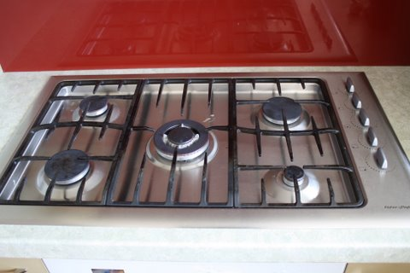
Everyday Interface Issues

Slide 12
HCI: yesterday -> today
Historically
HCI wasn’t a key issue when there were only a few computers in back rooms
Personal computers (e.g. Apple IIe from 1976, IBM PC from 1981, interfaces based on Xerox Star [Mac, Windows]) brought HCI to the common workplace and home
And then there’s the Internet -> Web -> widespread Social Media trajectory
Take banking
Used computers from Day 1, but over recent decades have transformed their interface to customers with ATMs and now online (Web) banking
Cell phones
Most people in the world have access to a cell phone (there’ll all computers, and increasingly ‘smart’)

Slide 13
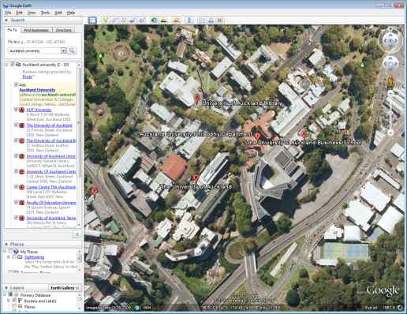
Applications of HCI
Google Earth

Slide 14
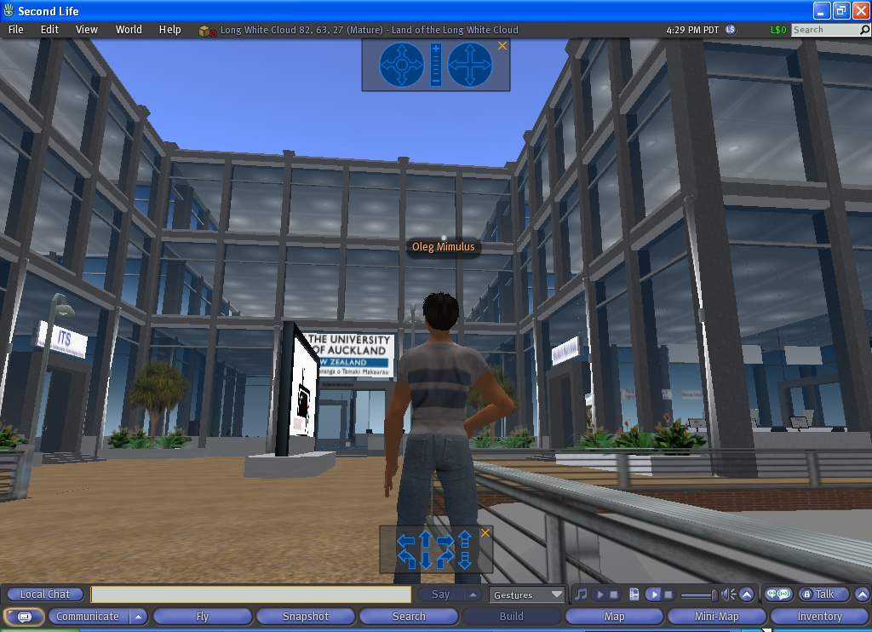
Applications of HCI
SecondLife

Slide 15

Applications of HCI
Kinect, Microsoft

Slide 16
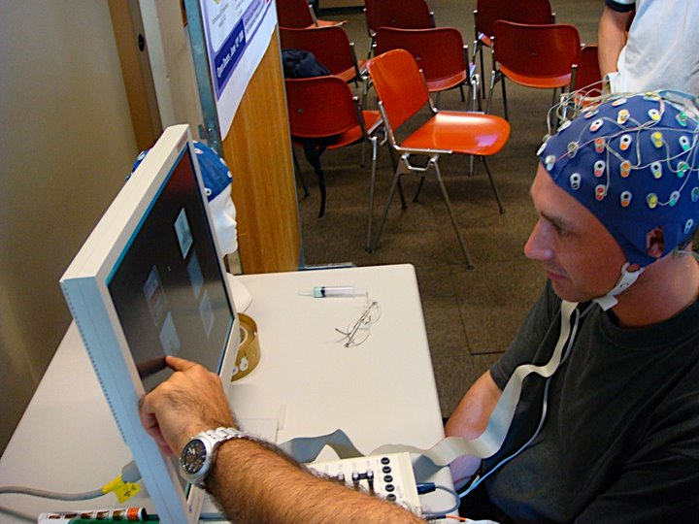
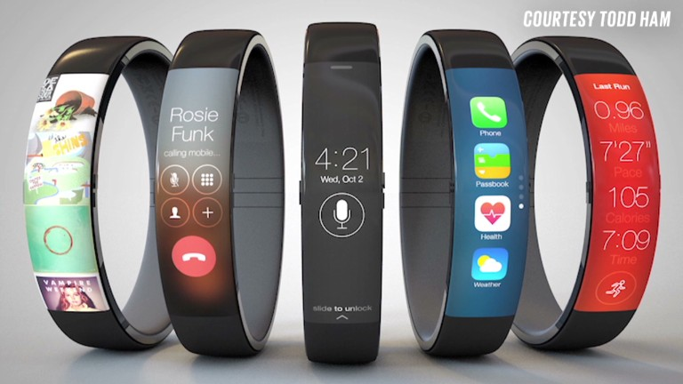
Applications of HCI
BCI at EPFL

Slide 17
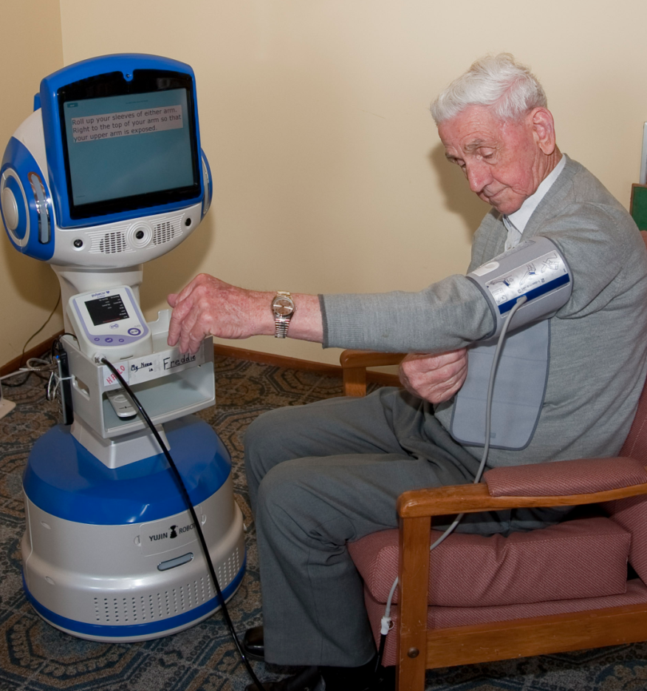
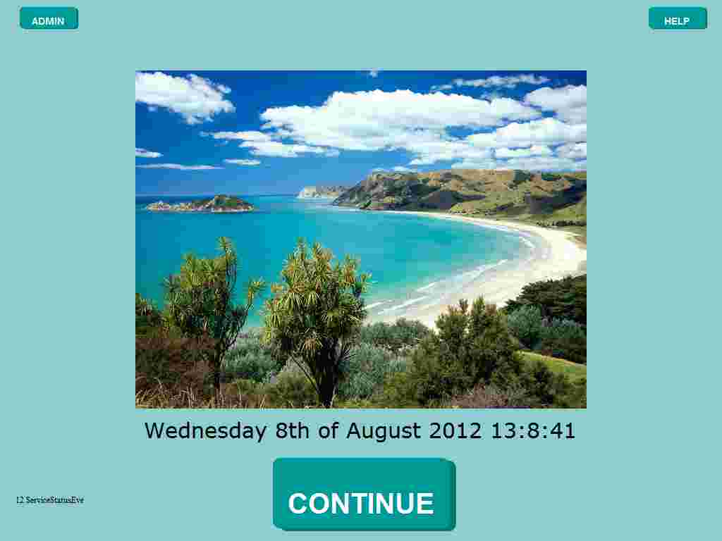
Local examples of applying UX Theory
Heath bots welcome screen

Slide 18
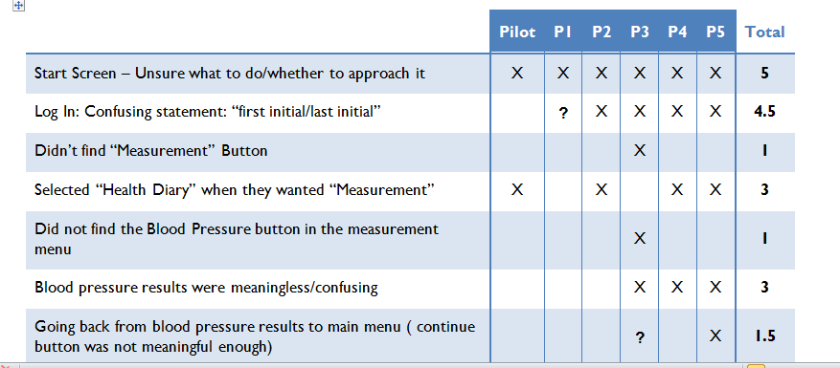
User test Results
Functionally the system is fantastic
But….

Slide 19
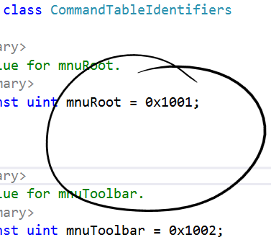
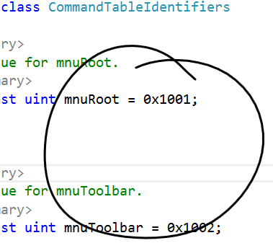
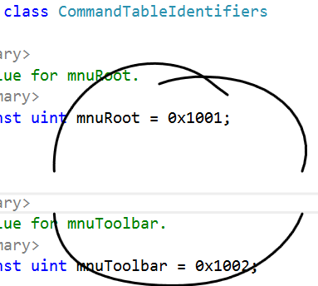
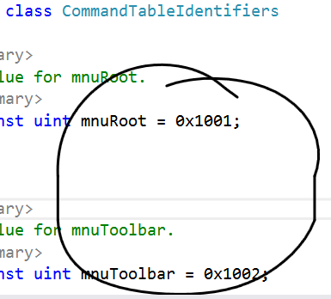
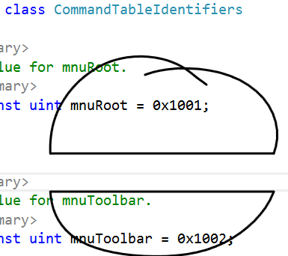
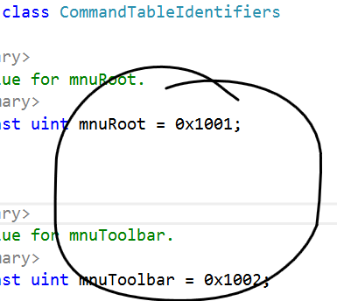
Freeform Ink on Program Code
People are used to annotating static documents, what about documents that change?

Slide 20
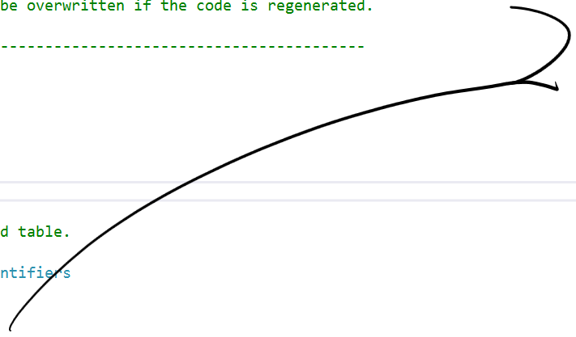
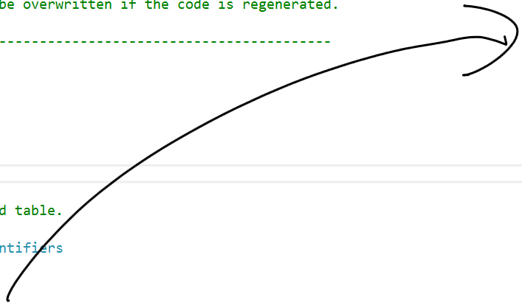
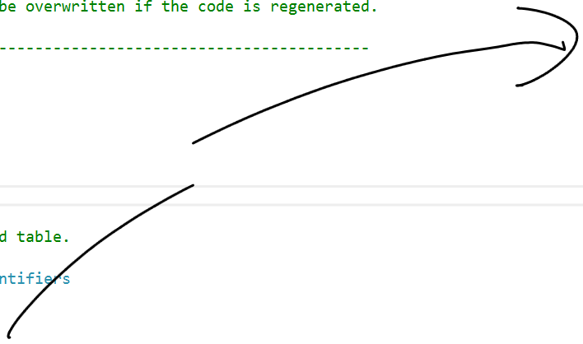
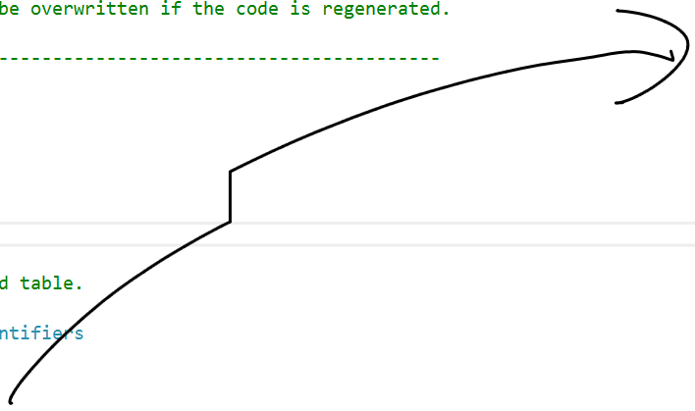
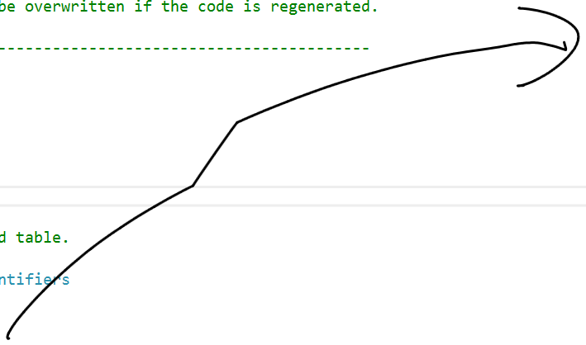
Freeform Ink on Program Code
People are used to annotating static documents, what about documents that change?

Slide 21
When a UX approach is taken
ALL new students to UoA have to do the Academic integrity online course
Goals
Not too onerous
Engaging
Message clear and all the bases covered
Quite a lot of constraints
Work with Cecil
Undergraduate and postgraduate
All faculties & courses
Limited time and budget
Developed by library staff

Slide 22
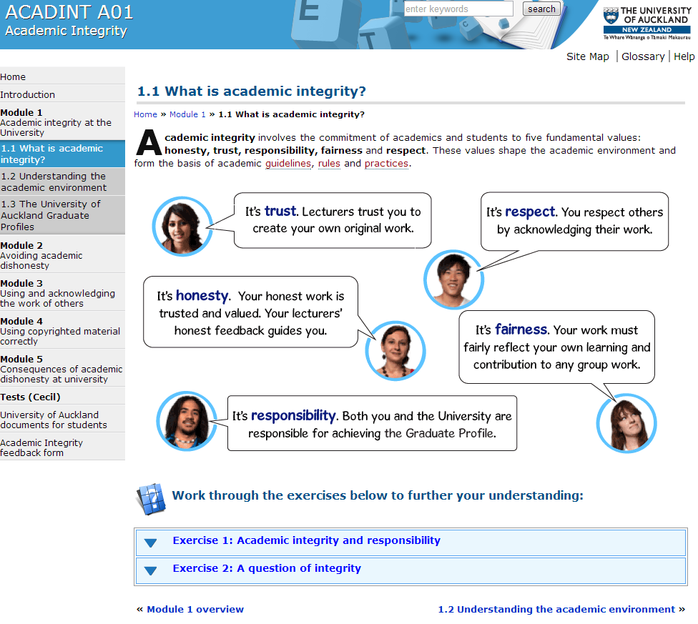
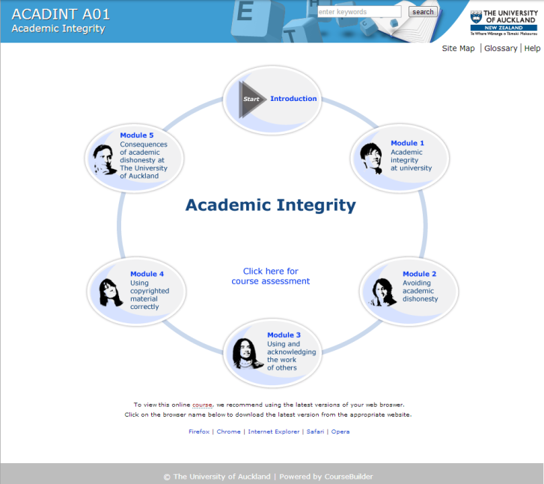
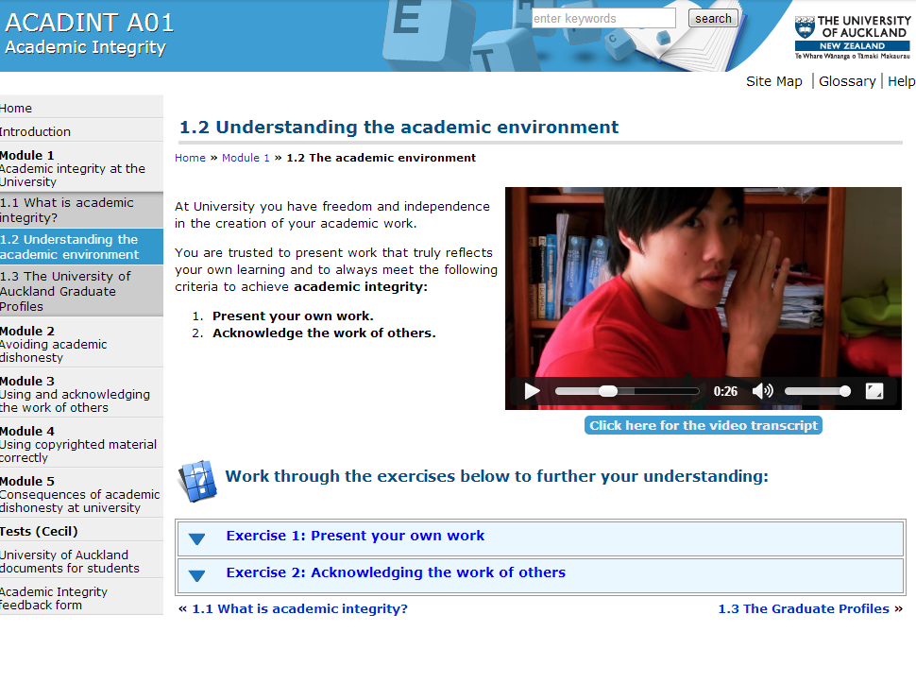
Academic Integrity Course
https://www.academicintegrity.auckland.ac.nz/index.html
Humour
Short sections
Easy navigation

Slide 23
Course Information COMPSCI 345 / SOFTENG 350
Course website https://www.cs.auckland.ac.nz/courses/compsci345s1c/
Lecture slide, lab slides, assignments, contact points, etc
Piazza piazza.com/aucklanduni.ac.nz/semester12015/cs345_se350/home
Forum – use for all course related questions and group formation for assignment 2. You can sign your self up using your uni email address upixxx@aucklanduni.ac.nz
Copyright material (book chapter scans)
Lecture recording links
Cecil for marks
Dropbox for assignment hand-in
Email to lecturers, tutors, and class or year representative for personal problems, support etc – note all course related questions put on Piazza.
No required textbook, library has
The Resonant Interface, Steven Heim, 2007
Human-Computer Interaction, by Dix, Finlay,
Abowd & Beale

Slide 24
CS601/602 students
Please email Jim and tell him you are in the course (jim@cs.auckland.ac.nz)
For your literature review you can choose any of the topics advertised here https://www.cs.auckland.ac.nz/courses/compsci345s1c/601_602.html
Direct any questions to Jim

Slide 25
Assessment
20% Assignments
https://www.cs.auckland.ac.nz/courses/compsci345s1c/assignments/
15% Test
https://www.cs.auckland.ac.nz/courses/compsci345s1c/exams/
65% Final Exam
2 hour
A pass in both coursework and the exam is required to pass this paper.
Assignment 2 to be undertaken in groups of 4
Tutorial in week 4 will concentrate on group working skills and group formation
Piazza will be used for groups to advertise for additional members
Groups benefit from mixed skills: design; programming; psychology
Assignments 1&3 are individual assignments
Plagiarism is not tolerated at UoA

Slide 26
Assignment 1
Usability Evaluation
In this case of a parking meter (will say more in coming lectures)
A central skill
As part of development team to iteratively guide making the best product
To support decision to purchase or adopt a package for an organisation

Slide 27
Assignment 2
Design
Thinking about the interaction (‘interaction design’)
Fit to the intended user, especially for the most common tasks
Lo-fi (paper) prototyping
The best way to avoid the designing becoming ‘fixed’ too early in the process
And it’s group work…

Slide 28
Group Work
Expectations of a BSc/BE graduate (Graduate Profile)
Work collaboratively with others, interacting effectively and demonstrating a respect for other individuals and groups.
Demonstrate a level of literacy, and written and oral communication skills which would enable them to competently undertake functions expected of a science graduate .
Group work can potentially develop the following skills transferable to the workplace:
the ability to listen to others and evaluate different points of view
the development of cooperation and planning skills
the development of leadership and shared leadership skills
the ability to work on large and/or complex projects
the ability to work with individuals from a range of cultures and backgrounds
Assignment contribution will be assessed individually
It’s the way almost all real software development is done

Slide 29
Assignment 3
Prototype
‘Realisation’ of the design
All the ‘small’ decisions that transform a design into software
Choice of controls and how they work, colour, font, icons, etc.
So much can go wrong (or make it so right!)
Also get to practice at web development, and to try a user test with your prototype
Note: although the same problem flows from A2-A3 you do not have to implement what you designed in A2

Slide 30
Lectures
3 lectures per week
Monday, Wednesday, Friday 11-12am,
Handouts on the course website
At least the day prior to lecture
Best to attend lectures
Lecturers provide examples/anecdotes
Chance to ask questions
Lecture slides are cryptic
Lecturers highlight the important aspects of a topic
In this course previously there was a grade point difference between those who attended class and those who didn’t
If you miss a lecture: get notes; talk to a classmate
Look at lecture recording (URL on Piazza)

Slide 31
Tutorials
You are enrolled in a 1 hour tutorial each week. Six choices available – please attend the correct tutorial (at least in the early weeks), all tutorials are fully subscribed
The tutors will conduct these sessions
Schedule of tutorials is as follows:
Week Topic Tutor
1 No tutorials
2 State Transition networks Bibin
3 Low fi prototyping Bibin
4 Group working (A2 group formation) tba
5 System Requirements tba
Break
Visual Aesthetics tba
7 No tutorial (Monday holiday)
8 DHTML and CSS tba
9 Morae tba
10 Assignment 3 clinic tba
11 Fitts’ and Hick’s Laws tba
12 No tutorials

Slide 32
General Information Points
Computer Science Support Group
UoA support resources
Tuakana for Maori and Pacific students
Student Reps

Slide 33
Class Representative (CS)
There can only be one!
Once elected, attend one AUSA Class Rep Information Session
TBA
Contact classreps@ausa.org.nz, 09 923 7385 or visit Old Choral Hall G15

Slide 34

Questions?
Nao robot

Slide 35
Today’s learning objectives
Meet the lecturers
Be able to define HCI
Be able to articulate the importance of HCI to the success of modern software
Be aware of the course structure and organisation
Appreciate the role of the assessable components in your learning of HCI

